Slide 1

Lecture 6
Verilog HDL
Peter Cheung
Imperial College London
URL: www.ee.imperial.ac.uk/pcheung/teaching/EE2_CAS/
E-mail: p.cheung@imperial.ac.uk
Notes:
This lecture is about Verilog HDL, which, together with another language VHDL, are the most popular hardware languages used in industry.
Verilog is only a tool; this course is about digital electronics. Therefore, I will NOT be going through Verilog as in a programming course - it would have been extremely boring for both you and me if I did. Instead, you will learn about Verilog through examples. I will then point out various language features along the way. What it means is that the treatment of Verilog is NOT going to be systematic or comprehensive – there will be lots of features you won’t know about Verilog. However, you will learn enough to specify and design reasonably sophisticated digital circuits, and you should gain enough confidence to learn the rest by yourself.
There are many useful online resources available on details of Verilog syntax etc.. Look it up as you need to and you will learn how to design digital circuit using Verilog through designing real circuits.
.

Slide 2
Lecture Objectives
By the end of this lecture, you should understand:
  The basic structure of a module specified in Verilog HDL
  Commonly used syntax of Verilog HDL
  Continuous vs Procedural Assignments
  always block in Verilog amd sensitivity list
  Nets vs variables
  The use of arithmetic and logic operations in Verilog
  The danger of incomplete specification
  How to specify clocked circuits
  Differences between blocking and nonblocking assignments
Notes:
Here is a list of lecture objectives. They are provided for you to reflect on what you are supposed to learn, and not as an introduction to this lecture.
I want, by the end of this lecture, to give you some idea about the basic structure and syntax of Verilog. I want to convince you that schematic capture is NOT a good way to design digital circuits. Finally, I want you to appreciate how to use Verilog to specify a piece of hardware at different levels of abstraction.

Slide 3
Schematic vs HDL
Schematic
HDL
Good for multiple data flow
Give overview picture
Relate directly to hardware
Don’t need good programming skills
High information density
Easy back annotations
Useful for mixed analogue/digital
Not good for algorithms
Not good for datapaths
Poor interface to optimiser
Poor interface to synthesis software
Difficult to reuse
Difficult to parameterise
Flexible & parameterisable
Excellent input to optimisation & synthesis
Direct mapping to algorithms
Excellent for datapaths
Easy to handle electronically (only needing a text editor)
Serial representation
May not show overall picture
Need good programming skills
Divorce from physical hardware
Notes:
You are very familiar with schematic capture. However modern digital design methods in general DO NOT use schematics. Instead an engineer would specify the design requirement or the algorithm to be implemented in some form of computer language specially designed to describe hardware. These are called “Hardware Description Languages” (HDLs).
The most important advantages of HDL as a means of specifying your digital design are: 1) You can make the design take on parameters (such as number of bits in an adder); 2) it is much easier to use compilation and synthesis tools with a text file than with schematic; 3) it is very difficult to express an algorithm in diagram form, but it is very easy with a computer language; 4) you can use various datapath operators such as +, * etc.; 5) you can easily edit, store and transmit a text file, and much hardware with a schematic diagram.
For digital designs, schematic is NOT an option. Always use HDL. In this lecture, I will demonstrate to you why with an example.

Slide 4
Verilog HDL
Similar to C language to describe/specify hardware
Description can be at different levels:
  Behavioural level
  Register-Transfer Level (RTL)
  Gate Level
Not only a specification language, also with associated simulation environment
Easier to learn and “lighter weight” than its competition: VHDL
Very popular with chip designers
For this lecture, we will:
  Learn through examples and practical exercises
  Use two examples: 2-to-1 multiplexer and 7 segment decoder
Notes:
I have chosen to use Verilog HDL as the hardware description language for this module. Verilog is very similar to the C language, which you should already know from last year. However, you must always remember that YOU ARE USING IT TO DESCRIBE HARDWARE AND NOT AS A COMPUTER PROGRAMME.
You can use Verilog to describe your digital hardware in three different level of abstraction:
Behavioural Level – you only describe how the hardware should behave without ANY reference to digital hardware.
Register-Transfer-Level (RTL) – Here the description assumes the existence of registers and these are clocked by a clock signal. Therefore digital data is transferred from one register to the next on successive clock cycles. Timing (in terms of clock cycles) is therefore explicitly defined in the Verilog code. This is the level of design we use most frequently in this course.
Gate Level – this is the lowest level description where each gate and its interconnection are explicitly specified.
Verilog is not only a specification language which tells the CAD system what hardware is supposed to do, it also includes a complete simulation environment. A Verilog compiler does more than mapping your code to hardware, it also can simulate (or execute) your design to predict the behaviour of your circuit. It is the predominant language used for chip design.
You will learn Verilog through examples and exercises, not through lecture. However, I will spend just this lecture to cover the basics of Verilog.

Slide 5
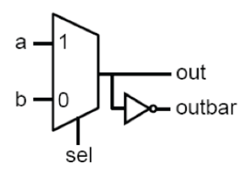
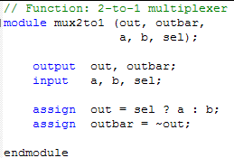
Structure of a Module
Verilog design contains interconnected modules
A module has collections of low-level gates, statements, and other modules
Here is an example of a simple module that describes a 2-to-1 multiplexer:
sel out
0 b
1 a
// to end-of-line is comment. Can also use /* … */ for multiline comments
Declare and name module; list its ports; terminate with ‘;’
Specify port as input, output (or inout if bidirectional)
Express modules behaviour; each statement executes in parallel; ORDER DOES NOT MATTER
Notes:
This is a Verilog module that specifies a 2-to-1 multiplexer. It is rather similar to a C function (except for the module keyword).
It is important to remember the basic structure of a Verilog module. There is a module name: mux2to1. There is a list of interface ports: 3 inputs a, b and sel, and 2 outputs out and outbar. Always use meaningful names for both module name and variable names.
You must specify which port is input and which port is output, similar to the data type declaration in a C programme.
Finally, the 2-to-1 multiplexing function is specified in the assign statement with a construct that is found in C. This is a behavioural description of the multiplexer – no gates are involved.
The last statement specifies the relationship between out and outbar. It is important to remember that Verilog describes HARDWARE not instruction code. The two assign statements specify hardware that “execute” or perform the two hardware functions in parallel. Therefore their order does not matter.

Slide 6
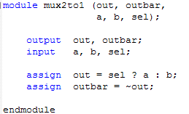

Continuous Assignment
Keyword assign specifies continuous assignment to describe combinational logic
Right-hand expression continuously evaluated …. responding to input changes immediately
Left-hand is a net driven with evaluated value
Left side must be a scalar, a net or a concatenation of nets and vector nets. (nets, vectors etc. will be described later)
All continuous assignments execute in parallel
Operators in expressions are low-level:
  Conditional assignment: (cond)? vTrue: vFalse
  Boolean: ~, &, |,
  Arithmetic: +, -, *
  Operators can be nested. For example, here is a 4-to-1 mux:
i3
i2
i1
out
i0
s0
s1
Notes:
Continuous assignment specifies combinational circuits – output is continuously reflecting the operations applied to the input, just like hardware.
Remember that unlike a programming language, the two continuous assignment statements here ARE specifying hardware in PARALLEL, not in series.
Here we also see the conditional statement that is found in C. This maps perfectly to the function of a 2-to-1 multiplexer in hardware and is widely used in Verilog.
Furthermore, there are many other Boolean and arithmetic operators defined in Verilog (as in C). Here is a quick summary of all the Verilog operators (used in an expression).
(What is “reduction and &”? I want you to find this yourself online.)

Slide 7
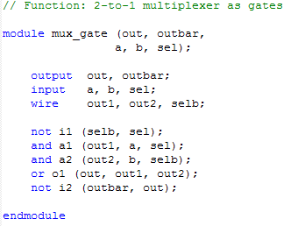
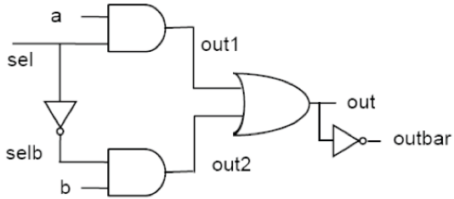
Description at Gate Level
Built-in logic gate primitives:
  and, nand, or, nor, xor, xnor, not, buf
Can use arbitrary number of inputs, e.g. and gate_name (out, in1, in2, in3, …)
Tri-state buffers: bufif1 and bufif0
Connect gates with nets using declaration keyword wire
and a1 (out1, a, sel);
This statement is an instantiation of an AND gate. a1 is the name of THIS particular AND gate.
Notes:
While the previous Verilog code for the 2-to-1 mux only specifies “behaviour”, here is one that specifies a gate implementation of the same circuit. Three types of gates are used: and, or and not gates. There are internal nets (declared as wire) which must also be declared and are used to connect gates together.
Keywords such as and, or and xor are special – they specify actual logic gates. They are also special in that the number of inputs to the and-gate can be 2, 3, 4, ….. Any length!
Note that this module uses TWO AND gates, and they have different names: a1 and a2. These are TWO separate instances of the AND gate. In software, “calling” a function simple execute the same piece of programme code. Here the two statements ”and a1 (out1, …” and “and a2 (out2 …” produce two separate piece of hardware. We say that each line is “instantiating” an AND gate.
Wiring up the gates is through the use of ports and wires, and depends on the positions of these “nets”. For example, out1 is the output net of the AND gate a1, and it is connected to the input of the OR gate itby virtual of its location in the gate port list.

Slide 8
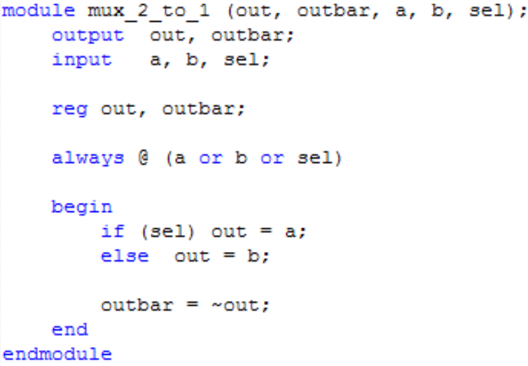
Procedural Assignment using “always”
Keyword always and initial are used to define procedural assignment, similar to procedures in software
Good for behavioural description of hardware including combinational and sequential logic
Support richer C-like constructs such as if, for, while, case etc.
Declarations same as before
Assignment inside an always block must be declared as variable data type such as reg (see later)
always block runs once whenever a signal in the sensitivity list changes value
Statements inside the always block are executed sequentially. ORDER MATTERS!
Sandwiched between begin/end
always @ (*)
Notes:
So far we have used Verilog in very hardware specific way. “assign” and using gate specification are special to Verilog. You do not find these in C.
Here is something that is more like C – and it is called “procedural assignment”. Typically we use something called “always” block to specify a “procedure”, i.e. a collection of sequential statements which are sandwiched between the begin-end construct.
The always block needs a sensitivity list – a list of signals which, if ANY of these signals changes, the always block will be invoked. You may read this block as:
“always at any changes in nets a, b or sel, do the bits between begin and end”.
Actually, if you are defining a combinational circuit module, an even better way to define the always block is to use:
….. always @ (*) .... // always at any change with any input signal
Inside the begin-end block, you are allowed to use C-like statements. In this case, we use the if-else statement. All statements inside the begin-end block are executed sequentially.

Slide 9
Verilog “register” is NOT what it appears!
Registers normally represents storage elements in digital logic, they need clock signals to update their output value
In Verilog reg is NOT the same as a digital register, it is used only to declare a variable that holds a value
Values of variables (declared as reg ) can be changed anytime in a simulation, and can be used for nets of a combinational circuit
In other words, in Verilog, reg is similar to declarations such as int, real etc. When you use:
reg signal_a;
whether a physical register (or D-FF) is sythesized to store signal_a or not would depend on the rest of the Verilog code.
Notes:
Note that Verilog keyword reg does not implies that there is a register created in the hardware. It is much more like declaring a variable that holds a value. It is a rule in Verilog that if you perform an assignment to a variable INSIDE an always block, that variable MUST be declared a reg, and NOT a net (wire). This is one of the few peculiarities of Verilog that can be confusing to students.

Slide 10
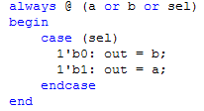

case statement – better alternative to if-else
case statement can often replace if-else construct within an always block, and provides better abstraction
Here is an example using the mux_2_to_1 module:
Notation for numbers:
<size> ‘ <base> <number>
2’b10 | 2 bit binary, v=2
‘b10 | Unsized binary 32-bit, v=2
31 | Unsized decimal, v=31
8’hAf | 8-bit hex, v=175
-16’d47 | 16-bit negative decimal, v=-47
Notes:
This is yet another way to specify the MUX circuit. It is still a procedural assignment with the always block. However, we replace the if-else statement with a “case” statement. The case variable is sel. Since sel is a 1-bit signal (or net), it can only take on 0 or 1.
Note that the various case values can be expressed in different number formats as shown in the slide. For example, consider 2’b10. The 2 is the number of bits in this number. ‘b means it is specified in binary format. The value of this number is 10 in binary.

Slide 11
n-bit signals - buses
Verilog is powerful in specifying multi-bit signals and buses.
Here is an example for 8-bit wide 2-to-1 multiplexer:
Notes:
This slide demonstrates why language specification of hardware is so much better than schematic diagram. By simply declaring the signals as a multi-bit bus (8 bits [7:0]), we change this module to one that specifies 8 separate 2-to-1 multiplexers.
Another useful way to specify a bus is using the concatenation operator: { …. } as shown above.
The concatenation operator is particularly useful in converting digital signals from one word length (i.e. number of bits in a word) to another. For example, to convert an 8-bit unsigned number a[7:0] to a 13-bit unsigned number b[12:0], you can simple do this:
assign b[12:0] = {5’b0, a[7:0]};

Slide 12
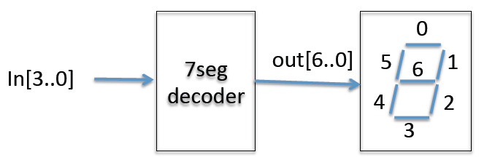
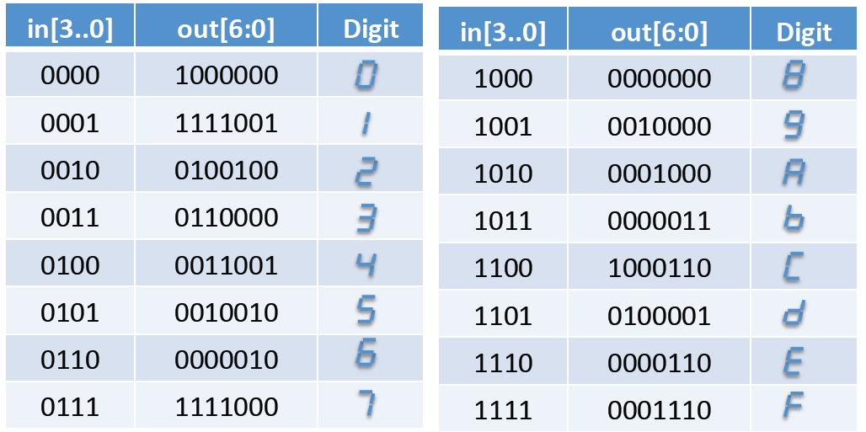
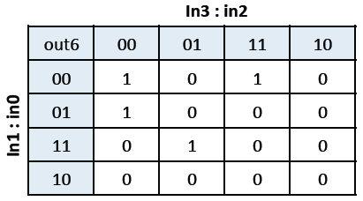
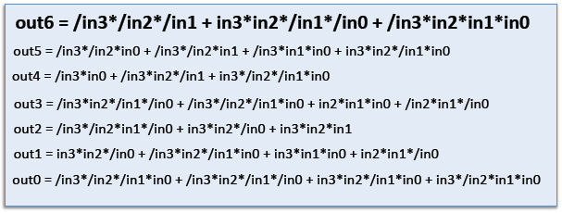
Putting everything together – 7 seg decoder
Notes:
Here is a simple example: the design of a 4-bit hex code to 7 segment decoder. You can express the function of this 7-segment decoder in three forms: 1) as a truth table (note that the segments are low active); 2) as 7 separate K-maps (shown here is for out[6] segment only); 3) as Boolean equations.
This is probably the last time you see K-maps. In practical digital design, you would rely heavily on CAD tools. In which case, logic simplifications are done for you automatically – you never need to use K-maps to do Boolean simplification manually!

Slide 13
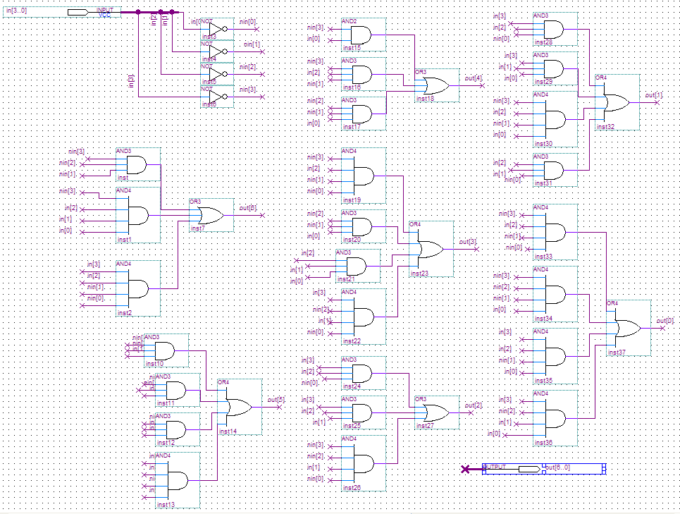
Method 1: Schematic Entry Implementation
TEDIOUS!!!!!
Notes:
Here is a tedious implementation in the form of schematic diagram of the 7 segment decoder as interconnected gates. Very hard to do and very prone to errors.

Slide 14
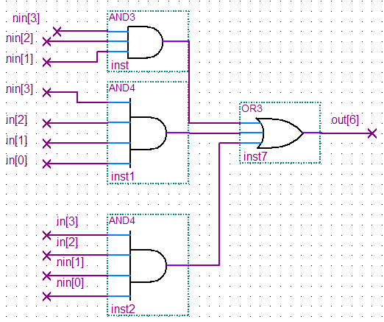

Method 2: Use primitive gates in Verilog
Equally TEDIOUS!!!!!
Direct mapping of gates to primitives
Notes:
One could take a group of gates and specify the gates in Verilog gate primitives such as and, or etc. Still very tedious. Here is the implementation for the out[6] output.

Slide 15

Method 3: Use continuous assignment in Verilog
Much Better?
Direct mapping of Boolean equation using continuous assignment..
Notes:
Instead of specifying each gate separately, here is using continuous assignment statement, mapping the Boolean equation direction to a single Verilog statement. This is better.

Slide 16
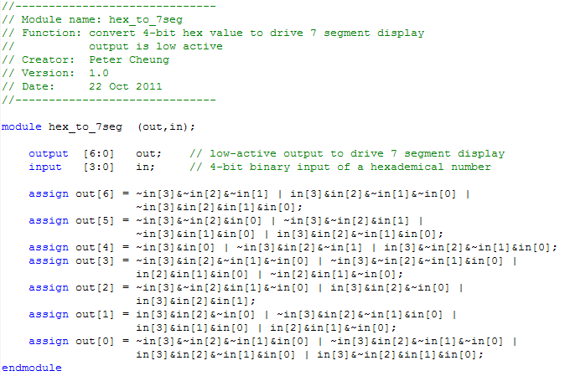
Hex_to_7seg.v
module & endmodule sandwich the content of this hardware module
good header helps documenting your code
specify interface to this module as viewed from outside
specify a 7-bit output bus, out[6] … out[0]
declaration of input and output ports
assign used to specify combinational circuit
Notes:
Here is the complete specification of the hex_to_7seg module using continuous assignment statements. It shows how one should write Verilog code with good comments and clear documentation of input and output ports.

Slide 17
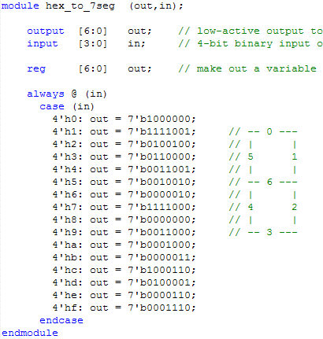
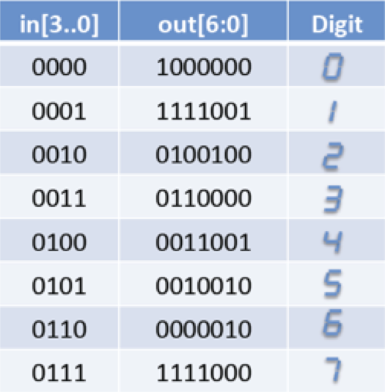
Method 4: Power of behavoural abstraction
BEAUTIFUL !!!
Direct mapping of truth table to case statement
Close to specification, not implementation
Notes:
Finally the 4th method is the best. We use the case construct to specify the behaviour of the decoder. Here one directly maps the truth table to the case statement – easy and elegant.
Instead of using: always @ (in), you could also use always @*

Slide 18
From Verilog code to FPGA hardware
Verilog code
…. If (sel) out = a;
else out = b;
FPGA specific hardware (LE, memory etc)
Elaboration: checking syntax, expanding and creating instances etc.
Place & Route: Fix the locations and wirings of all the hardware blocks for a specific FPGAs
Expanded Verilog code
Physical location of hardware and interconnect
Compilation: behaviour description to gate netlist or internal format related to hardware
Assembler: Produce the binary bit pattern needed to program (or configure) the FPGA
Gate netlist
AND G1(n1,n2,n3)
NOT G2(n4,n1)
……..
Programming (Configuration) bitstream
Synthesis: optimise logic, tradeoff amount of hardware with speed etc.
Technology mapping: map hardware to LEs, flipflops, memory blocks, multipliers etc.
Optimised netlist
NAND K1(n4,n2,n3)
……
Notes:
How is a Verilog description of a hardware module turned into FPGA configuration? This flow diagram shows the various steps taken inside the Quartus Prime CAD system.

Slide 19
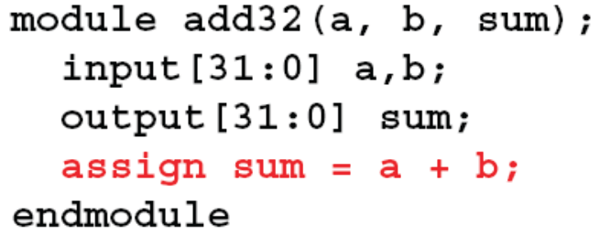
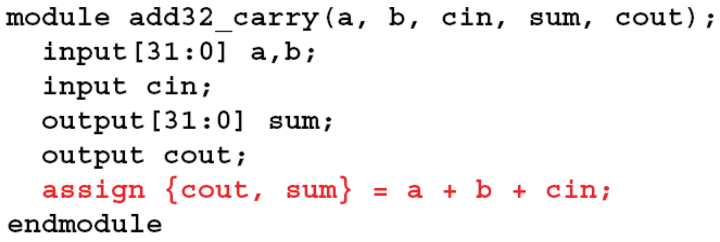
Power of Verilog: Integer Arithmetic
Arithmetic operations make computation easy:
Here is a 32-bit adder with carry-in and carry-out:
Notes:
Verilog is very much like C. However, the declaration of a, b and sum in the module add32 specifies the data width (i.e. number of bits in each signal a, b or sum). This is often known as a “vector” or a “bus”. Here the data width is 32-bit, and it is ranging from bit 31 down to bit 0 (e.g. sum[31:0]).
You can refer to individual bits using the index value. For example, the least-significant bit (LSB) of sum is sum[0] and the most-significant bit (MSB) is sum[31]. sum[7:0] refers the the least-significant byte of sum.
The ‘+’ operator can be used for signals of any width. Here a 32-bit add operation is specified. sum is also 32-bit in width. However, if a and b are 32-bit wide, the sum result could be 33-bit (including the carry out). Therefore this operation could result in a wrong answer due to overflow into the carry bit. The 33th bit is truncated.
The second example module add32_carry shows the same adder but with carry input and carry output. Note the LHS of the assign statement. The {cout, sum} is a concatenation operator – the contents inside the brackets { } are concatenated together, with cout is assigned the MSB of the 33th bit of the result , and the remaining bits are formed by sum[31:0].

Slide 20
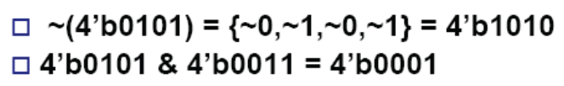

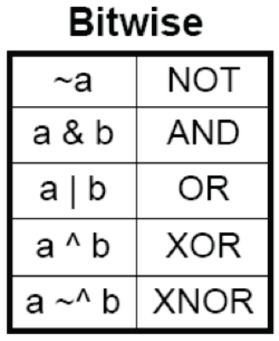
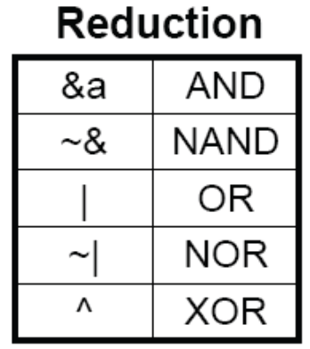
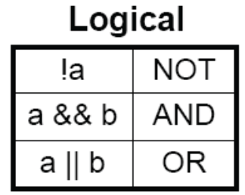
Different types of Boolean Operators
Bitwise operators: perform bit-sliced operations on vectors bit by bit
Logical operators: return true or false (1-bit) results
Reduction operators: act on each bit of a SINGLE input vector
Notes:
There are three different types of Boolean operators:
Bitwise operators perform what you would expect as if there are parallel gates used for each bit of the operands. Therefore a&b means that each bit from a and b is passed through an AND-gate.
Logical operators only result in 0 or 1 (i.e. 1-bit result) In this example !a (not a) where a = 0101, will result in first, a being evaluated as a logical value (i.e. logical ‘1’ or true). Therefore the result ~a is logical 0 (or false).
Reduction operators is applied to a single operand (and sometimes known as unary operators). It performs the operation one-bit at a time to the operand.

Slide 21
Beware of Incomplete Specification
Intention
What you may write, but wrong!
Notes:
Assume that we want to specify a 3-to-1 multiplexer as shown on the left. On the right is an attempt to specify this using the always + case construct in Verilog.
The case variable ‘sel’ is 2-bit wide, and therefore has 4 possibilities. The case statement only specifies three of the four possible cases.
This is known as an “incomplete specification”.
In Verilog, there is this rule:
If something is not completely specified, the output must retain its previous value when the unspecified condition occurs.

Slide 22
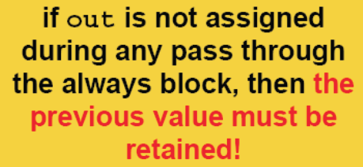
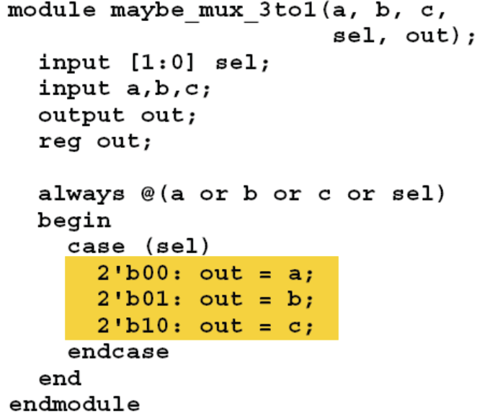
Incomplete specification: adds unwanted latch circuit
Synthesized Circuit
When sel = 2’b11, G = 0, therefore the latch stores the previous output value as required by Verilog in this situation.
Notes:
The consequence of this is an unexpected extra latch being added to the hardware.
In order to cope with the unspecified condition of sel = 2’b11, the output of the MUX is fed to be latch.
Noted that a latch is level-triggered; a flipflop is edge-triggered. A latch has the property that when the gate input G is high, Q = D (i.e. it is transparent: input goes straight to output). If G is low, the latch become opaque, meaning that it retains the previous value.
The green shaded latch in the diagram and the controlling NAND gate are the unintended consequences of this incompletely specified 3-to-1 multiplexer.

Slide 23
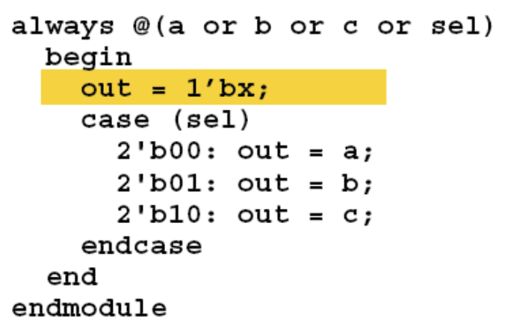
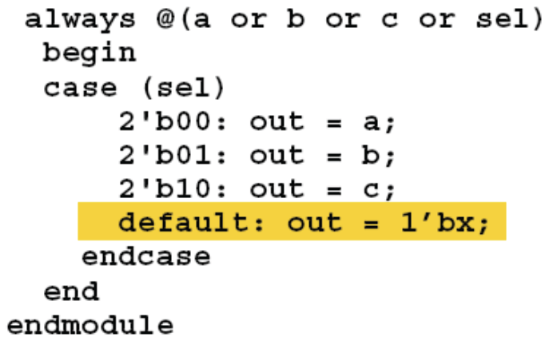
Always avoid incomplete specification
Solution 1: Precede all conditionals with a default assignment for all signals:
Solution 2: Fully specify all branches of if-else construct, or include a default statement in case construct:
Notes:
There are two solutions to avoid the unintended latch being added.
Solution 1 is to put outside the case statement a “default” value for out. Here 1’bx (i.e. ‘x’) means undefined.
Solution 2 is better: inside the case statement block, always add the default line. This will catch ALL the unspecified cases and avoid the introduction of the spurious unintended latches.
Lesson: always include a default assignment in any case statement to capture unintended incomplete specification.

Slide 24
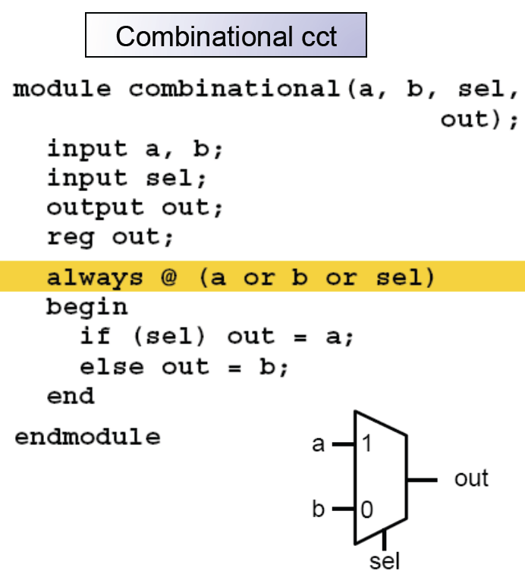
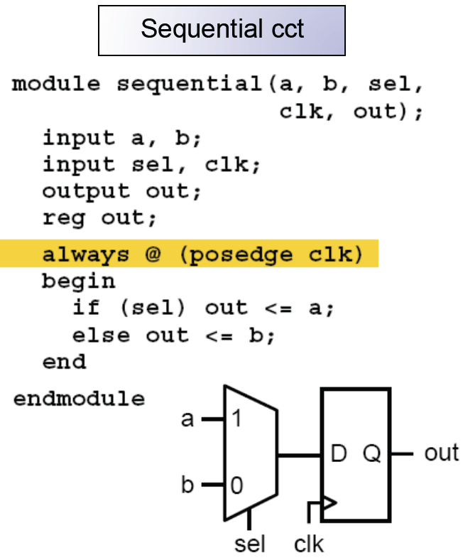
How to specify a sequential circuit?
Edge-triggered flipflop is specified with: always @ (posedge clk):
Notes:
We have previously seen the 2-to-1 MUX being specified as combinational circuit in Verilog using the always construct with the sensitivity list.
The right-hand diagram shows how a clocked sequential circuit is being specified using always block, but with a sensitivity list that includes the keyword posedge (or negedge). Note that the clocking signal clk is an arbitrary name – you could call it “fred” or anything else!
The sensitivity list NO LONGER contains the input signals a, b or sel. Instead the hardware is specified to be sensitive the positive edge of clk. When this happens, the output changes according to the specification inside the always block.
Two assignments (“=“ and “<=“) are shown here. I will explain the difference between these later.

Slide 25
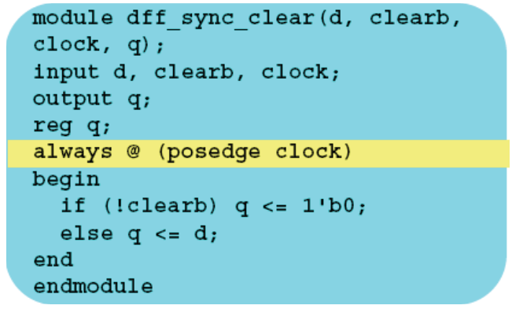
Synchronous clear in D-flipflop
posedge and negedge makes an always block sequential and edge-triggered
Sensitivity list in a sequential always block determines what circuit is synthesized
D flipflop with synchronous clear
clk
d
clearb
q
+ve edge on clock triggers action in always block
Beware of race condition if you have two or more always blocks – they execute in parallel!
Notes:
Therefore in Verilog, you specify flipflops using always block in conjunction with the keyword posedge or negedge.
Here is a specification for a D-flipflop with synchronous clear which is low active (i.e. clear the FF when clearb is low).
You may have more than one always block in a module. But if this is the case, beware that the two always blocks will execute in parallel. Therefore they must NOT specify the same output, otherwise a race condition exists and the result is unpredictable.

Slide 26
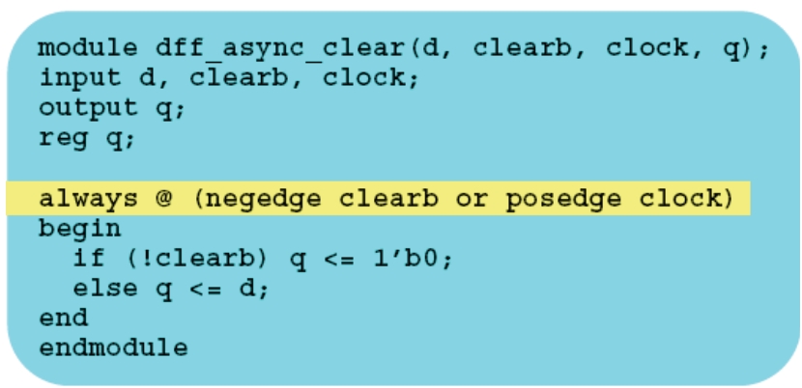
Asynchronous clear in D-flipflop
If one signal in the sensitivity list uses posedge or negedge, ALL signals must also specify an edge. This syntax is wrong: always @ (clearb or posedge clock)
D flipflop with asynchronous clear
clk
d
clearb
q
+ve edge on clock OR clearb trigger action in always block
Notes:
Here is a specification for asynchronous clear of the D-flipflop. Either positive edge on clock or negative edge on clearb will cause the statements inside the always block to take effect.
I must remind everyone that the code shown here is a specification. They are synthesised into logic circuits – they are NOT executed as in a C programme.

Slide 27
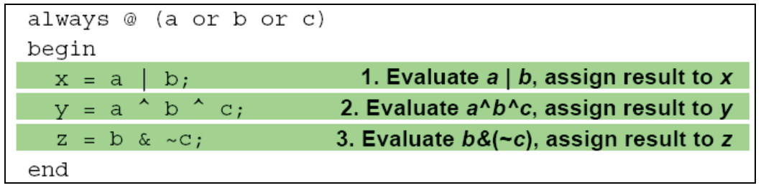
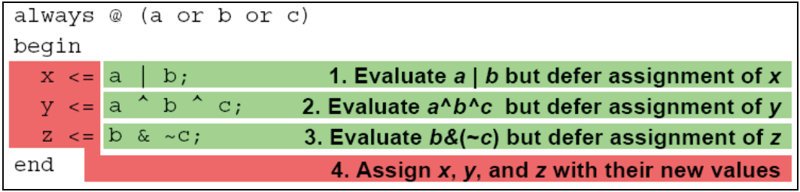
Blocking vs Non-blocking Assignments
Verilog has two different types of assignments: blocking & nonblocking.
Blocking assignments = are executed in the order they appear, therefore they are done one after another. Therefore the first statement “blocks” the second until it is done, hence it is called blocking assignments.
a = b;
b = a;
// both a & b = b
blocking
blocking
Non-blocking assignments <= are executed in parallel. Therefore an earlier statement does not block the later statement. Note the subtle effect this has within always block:
a <= b;
b <= a;
// swap a and b
Non-blocking
Non-blocking
Notes:
In Verilog ‘=‘ is known as blocking assignment. They are executed in the order they appear within the Verilog simulation environment. So the first ‘=‘ assignment blocks the second one. This is very much like what happens in C codes.
In the top left example, both a and b eventually have the value b.
In the top right example, each statement is evaluated in turn and assignment is performed immediately at the end of the statement.
Non-block assignment is ‘<=‘, and statements with this assignments are executed in parallel (i.e. order do not matter).
In the bottom left example, a and b are swapped over because you can view that the two assignments happen at the same time.
In the bottom right example, three evaluations are made, and the assignment to x, y and z happens at the same time on exiting from the always block.

Slide 28
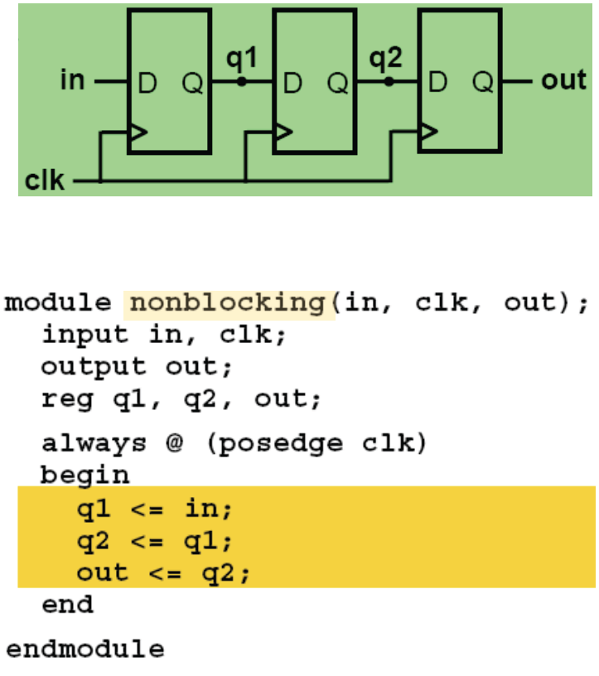
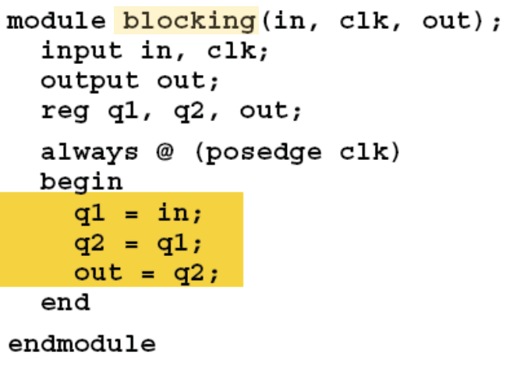
Be careful to use the correct assignment
Here are two versions of a 3-stage shift register consisting of 3 flipflops using blocking and nonblocking assignments.
Will they give the same results?
Notes:
Understanding the difference between ‘=‘ and ‘<=‘ is important. Suppose we want to specify a three-stage shift register (i.e. three D-FF in series as shown in the schematic).
Here are two possible specification. Which one do you think will create the correct circuit and which one is wrong?

Slide 29
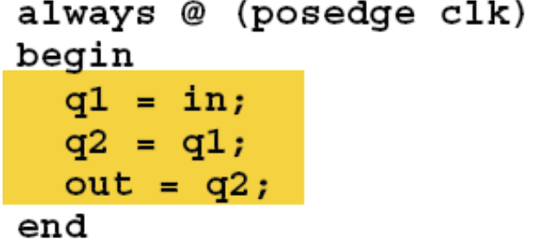
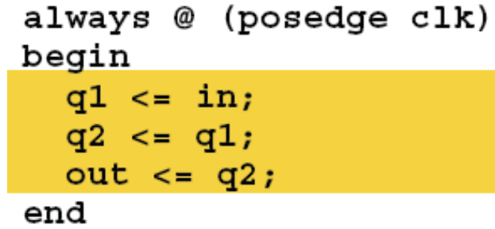
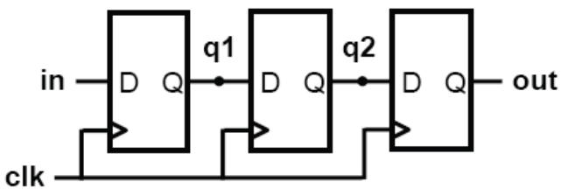
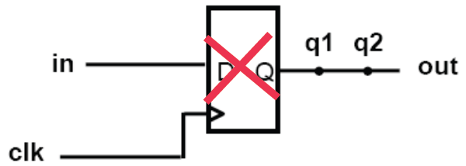
Use NONBLOCKING assignment for sequential logic
At each rising clock edge:
  q1 = in,
  then q2 = q1 = in,
  then, out = q2 = q1 = in.
Therefore out = in, which is NOT the intention.
At each rising clock edge, q1, q2 and out simultaneously receive the old values of in, q1, q2 respectively.
Notes:
The left hand specification is wrong. Since the three assignments are performed in sequence, out = q2 = q1 = in. Therefore the resultant circuit is ONE D-flipflop.
The right hand side is correct. q1, q2 and out are updated simultaneously on exit from the always block. Therefore their “original” values MUST be retained. Hence this will result in three D-flipflops being synthesised (i.e. created).
In general, you should always use ‘<=‘ inside an always block to specify your circuit.

Slide 30
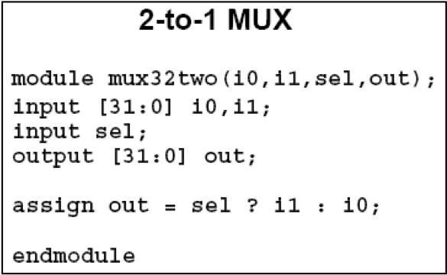
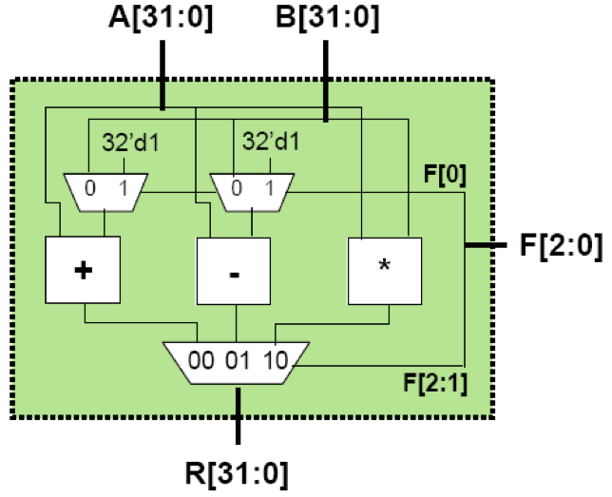
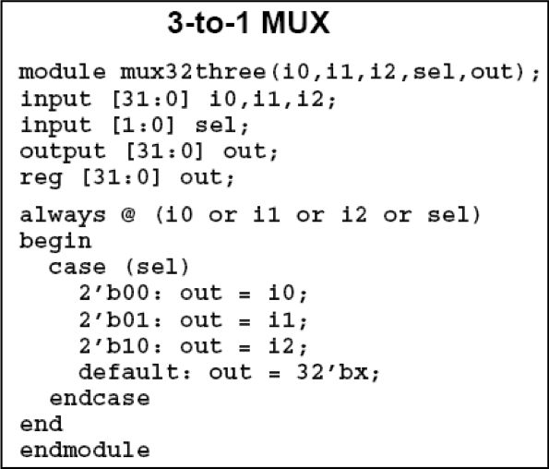
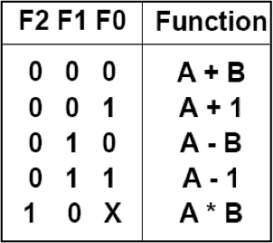
A larger example – 32-bit ALU in Verilog
Here is an 32-bit ALU with 5 simple instructions:
Notes:
Now let us put all you have learned together in specifying (or designing) a 32-bit ALU in Verilog.
There are five operators in this ALU. We assume that there are three arithmetic blocks, and three multiplexers (two 2-to-1 MUX and one 3-to-1 MUX).

Slide 31
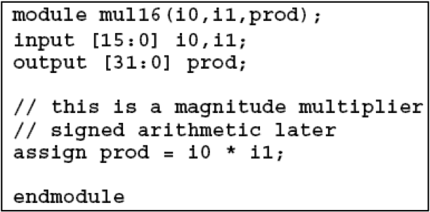
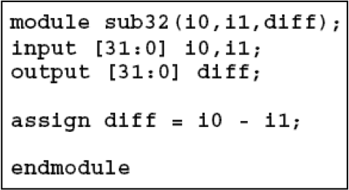
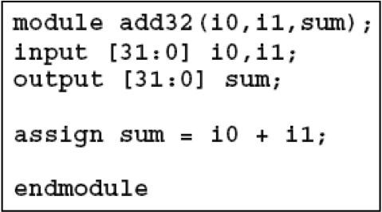
The arithmetic modules
Here is an 32-bit ALU with 5 simple instructions:
Notes:
Each hardware block is defined as a Verilog module. So we have the following modules:
mux32two – a 32-bit multiplexer that has TWO inputs
mux32three – a 32-bit multiplexer that has THREE inputs
mul16 – a 16-by-16 binary multiplier that produces a 32-bit product
add32 – a 32-bit binary adder
sub32 – a 32-bit binary subtractor

Slide 32
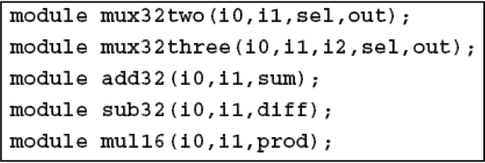
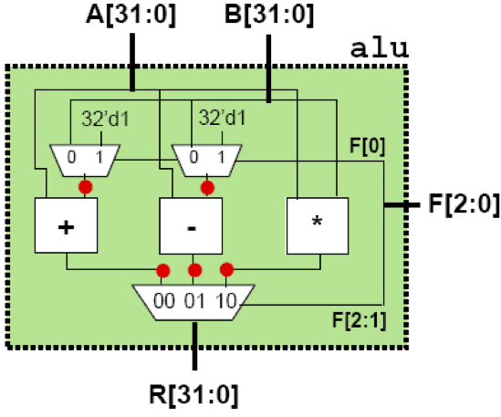
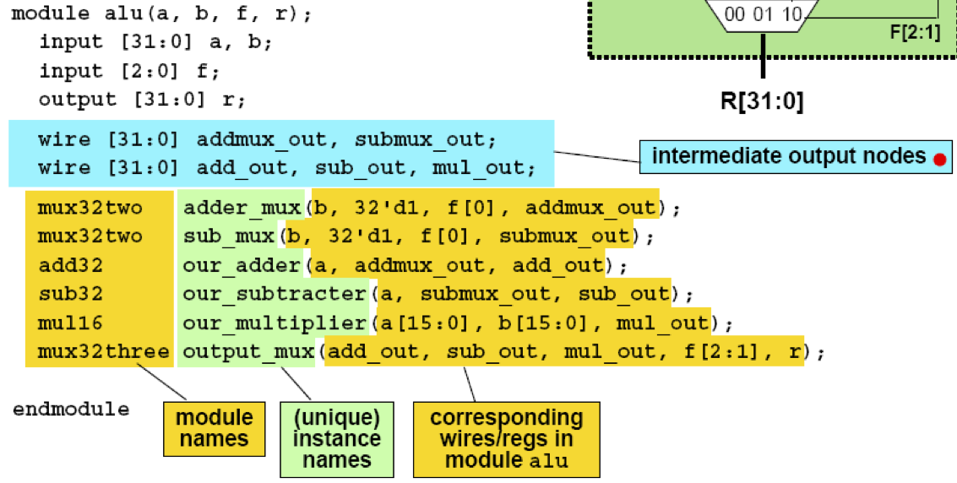
Top-level module – putting them together
Given submodules:
Notes:
Now let us put all these together.
Note that mxu32two is being used twice and therefore this is instantiated two times with two different instance names: adder_mux and sub_mux.
Connections between modules are implicit through the use of signal names. For example, the 16-bit inputs to the multiplier are taken from the lower 16-bits of a and b inputs (i.e. a[15:0] and b[15:0]).

